Slide 1

HD REALTY HOMES CO.
01
Utah Real Estate
Sales Analysis and Predictive Modeling
BY: JAYLA HASKINS

Slide 2

Synopsis
Analyze Utah’s real estate market, identify key pricing drivers, and build a predictive model to support pricing strategies for real estate professionals.
Main Findings:
Property Prices: Median listing prices are below $529,000; farms and newer homes are valued higher.
Predictive Modeling: K-Nearest Neighbors (KNN) achieved 99.54% accuracy in price prediction.
Actionable Insights: Focus on key property features like bedrooms and modernity for pricing strategies.
Next Steps: Improve model accuracy through tuning and refine insights to support real estate investment strategies.
02

Slide 3
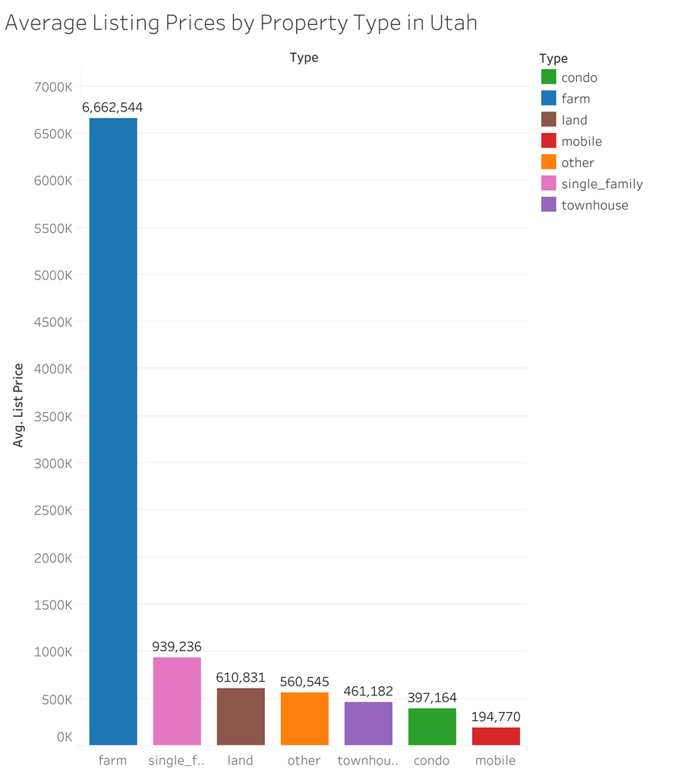
Inferential Outcomes
What Drives Property Prices?
Tested with an Analysis of Variance (ANOVA)
Bedroom count impacts price significantly
Farm properties are the most expensive
Tested with a T-test
Properties built after 2000 are valued higher
Garage presence has no significant effect
Tested with an Analysis of Variance
Lot size and garages weakly correlates with price

Slide 4
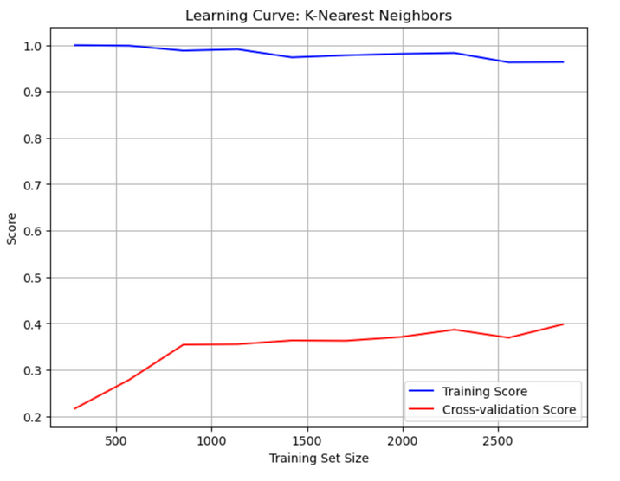
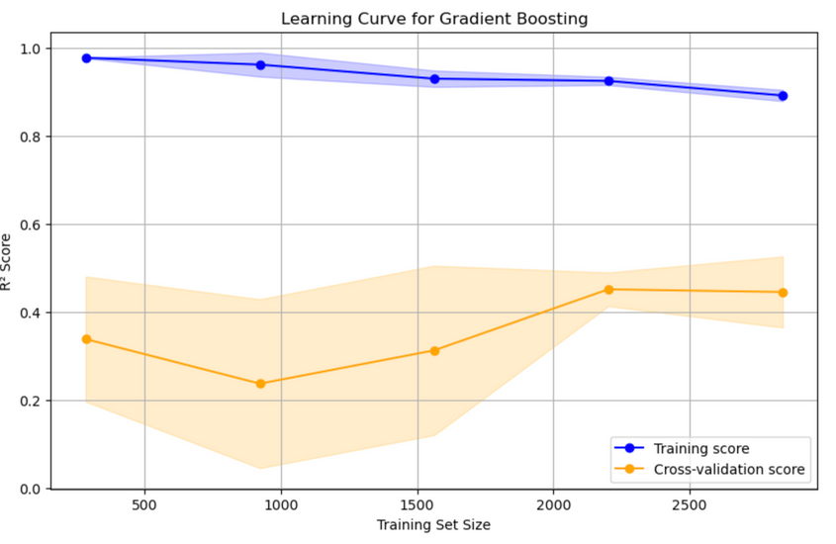
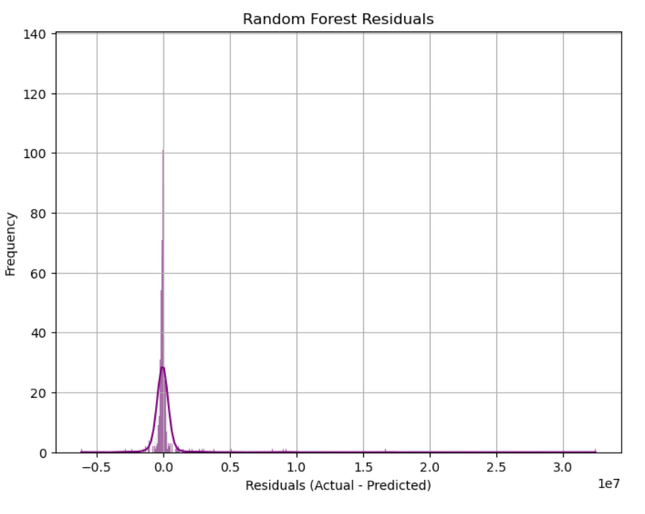
Top 3 Models Tested
10
K-Nearest Neighbors
Gradient Boosting
Random Forest
99.54% Accuracy
56% - 65% Accuracy
52%
Top Performance
Moderate Performace
Underperformed

Slide 5
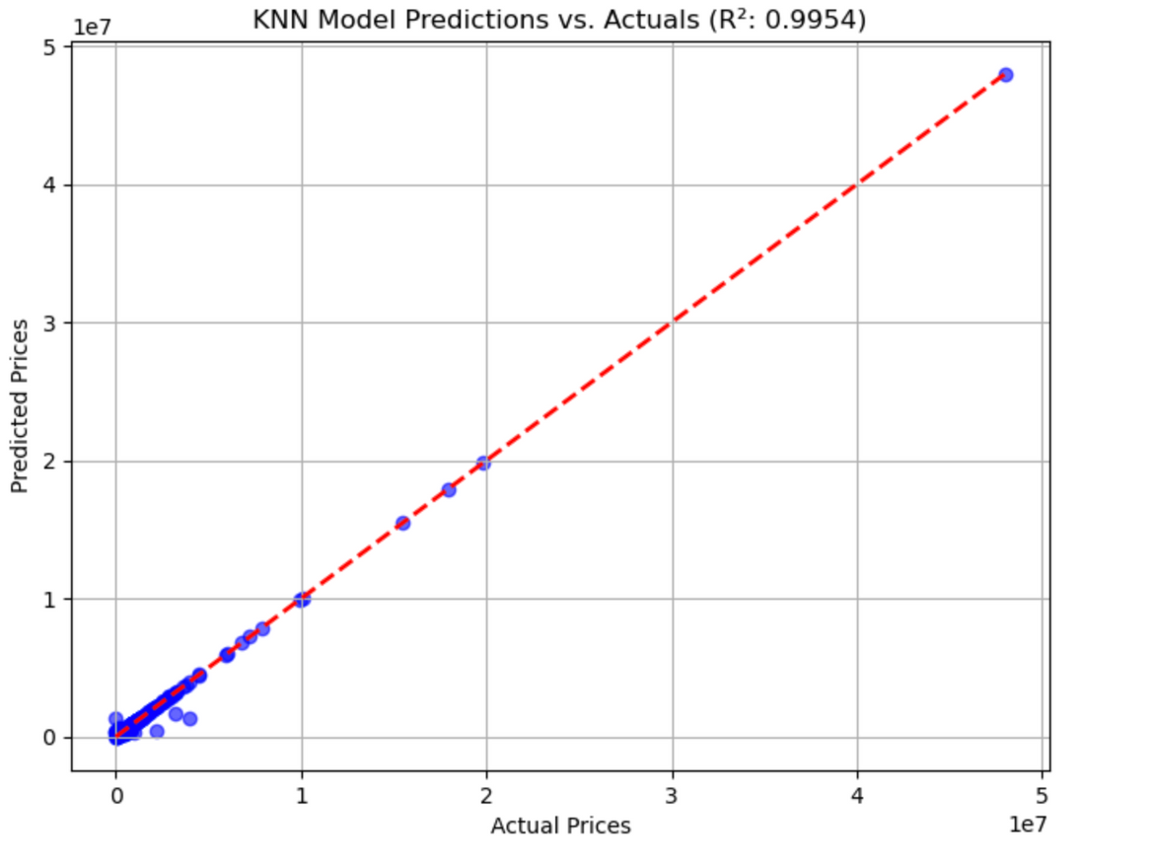
KNN in Action
09
Utility:
Provides accurate price estimates based on property features
Target Users:
Real estate professionals, investors, and analysts
Potential Impact:
Better pricing strategies, informed investments

Slide 6
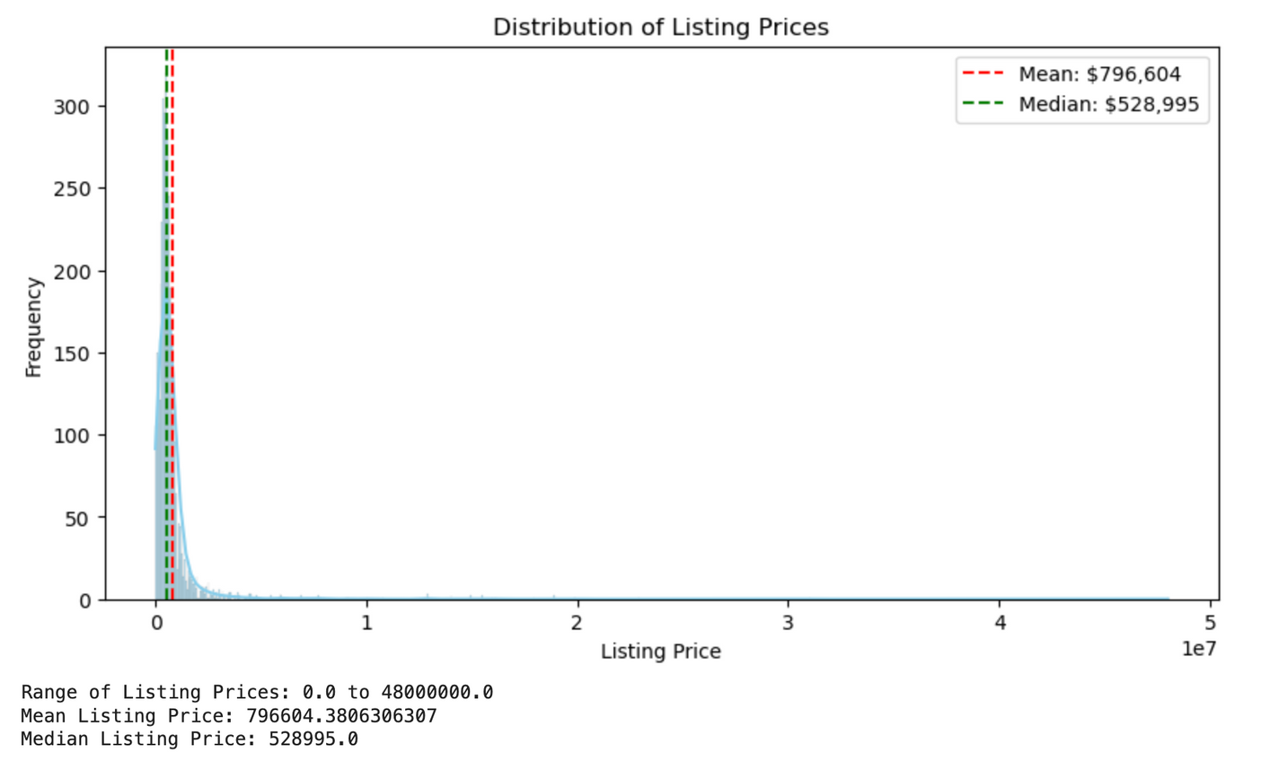
Trends in Utah Real Estate
10
Listing Prices
Median vs. Outliers

Slide 7
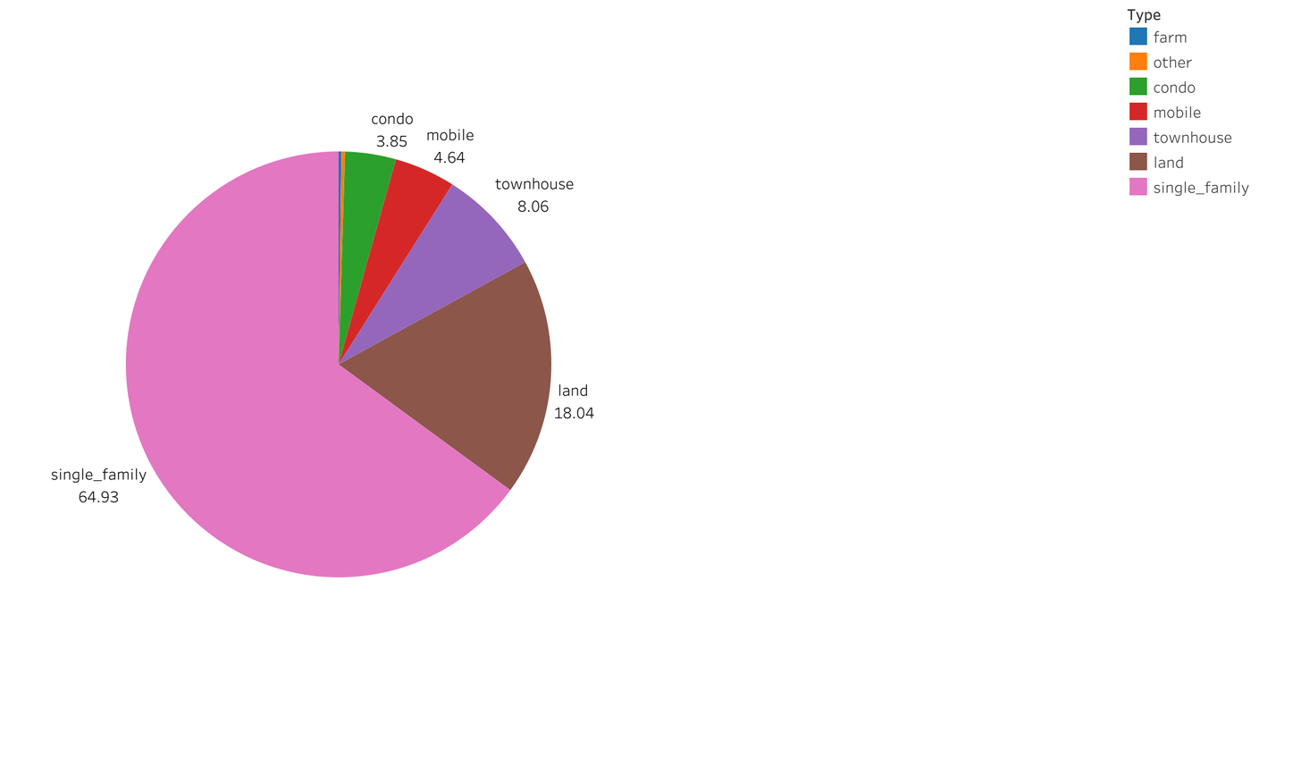
Trends in Utah Real Estate
10
Property Types
Market share by Property Type

Slide 8
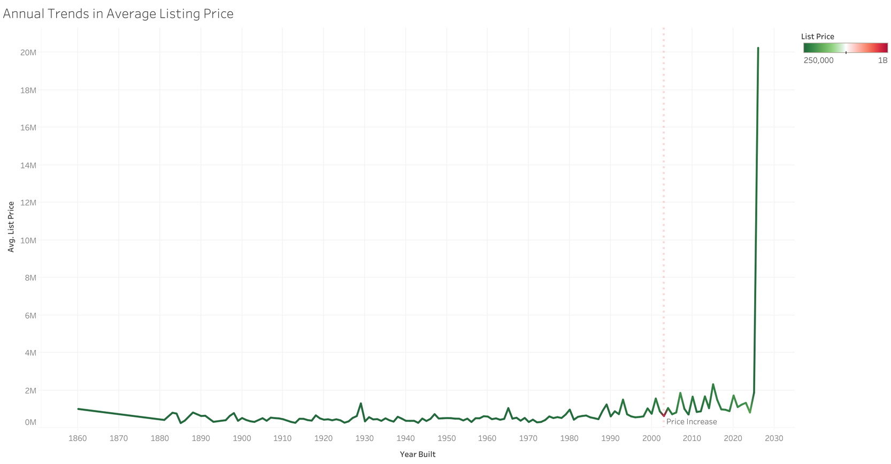
Trends in Utah Real Estate
10
Temporal Trends
Annual changes in average prices

Slide 9

Appendix & Next Steps
External Resources: Apify API, Realtor.com data
FUTURE DIRECTIONS
Develop geospatial models for location insights.
Build user-friendly dashboards integrating these findings.
Explore advanced modeling techniques like deep learning.
01

Slide 10

Contact Us
23
Reach out to us for inquiries or comments.
Git Hub
PHONE NUMBER
spryaiservices@gmail.com
EMAIL ADDRESS
www.hdrealtyhomes.com
WEBSITE

